Slide 1

Introduction to Cloud Computing
Week 2
Cloud Computing Fundamentals
CS-4037
Muhammad Sudais
muhammad.sudais.v@nu.edu.pk

Slide 2
CHAPTER 1 Cloud Computing Fundamentals
|LEARNING MICROSOFT AZURE

Slide 3
What Is Cloud Computing
Cloud computing is a significant technological innovation that delivers various services through the internet, including web servers, databases, data storage, virtual machines, applications, network infrastructure, security tools, software, and other IT infrastructure. Cloud computing refers to the virtual storage and access of data and information over the internet, with the actual computing processing transpiring in the cloud.

Slide 4
Benefits for Development Teams
Cloud computing enables software developers, engineers, and IT professionals to create, test, and deploy technical cloud solutions effectively and securely. Teams expanding their work on-premises may miss the benefits of cloud computing systems.

Slide 5
Advantages of Cloud Engineering
Cloud engineering offers better speed of development, testing, maintainability, automation, and scalability. Engineering and business teams can leverage cloud computing capabilities to enhance productivity and performance.

Slide 6
Infrastructure as Code (IaC) and Automation
Infrastructure as Code (IaC) makes development easier for developers and DevOps teams, allowing more consistency and replication across environments. The automation benefits will be discussed in later chapters.

Slide 7
Low-Code/No-Code Platforms
Low-code/no-code platforms such as Power Apps and Azure Logic Apps enable IT professionals with fewer programming skills to build applications quickly. These platforms provide flexibility for fast development.

Slide 8
Collaboration in the Cloud
Cloud-based tools, like Azure DevOps, enable better collaboration between development and operations teams. Agile planning, CI/CD, testing, and project management are streamlined with these all-in-one platforms.

Slide 9
Challenges of Digitalization
Although digitalization and cloud computing offer many benefits, adapting to the rapid technological evolution is challenging. Cloud computing fundamentals are necessary to overcome these barriers.

Slide 10
Cloud Data Centers
Data centers are the backbone of cloud computing, housing servers that provide services such as storage, computing power, and network connectivity. These facilities are designed with redundancy, security, and efficiency in mind.

Slide 11
Cloud Computing Benefits
Businesses and organizations choose cloud computing for its speed, reliability, financial savings, and security. It offers numerous advantages for modernizing systems and staying competitive.

Slide 12
Growth of Cloud Computing
Cloud computing continues to grow with technological innovations and sustainability efforts driving its evolution. The growing demand for cloud services positions it as a critical technology for the future.

Slide 13
Cloud Computing vs. Virtualization
Cloud: A shared environment with scalable resources
Virtualization: Simulating multiple machines or resources

Slide 14
Cloud Computing vs. Virtualization
Cloud: A shared environment with scalable resources
Virtualization: Simulating multiple machines or resources

Slide 15
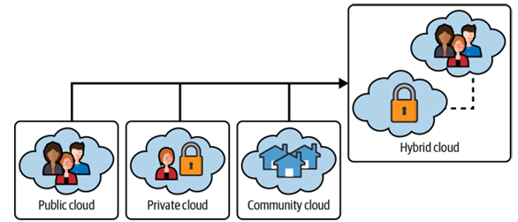
Cloud COMPUTING DEPLOYMENT MODELS
Describes different platforms and access levels of cloud computing.
Public Cloud
Private Cloud
Hybrid Cloud
Community Cloud
Multi-Cloud

Slide 16
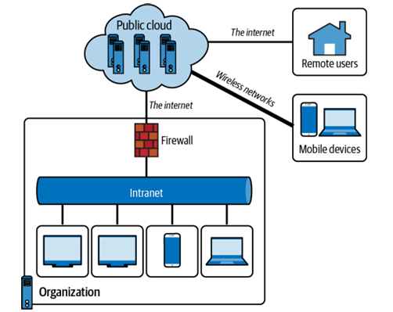
Public Cloud
Accessible to the public:
Organizations or individuals can use the public cloud for services.
Cloud Providers:
Azure, AWS, and others provide computing resources (OS, CPU, memory, storage, etc.).
Shared Infrastructure:
Resources securely shared among multiple customers or organizations.
Payment Options:
Subscription-based or pay-as-you-go (e.g., Azure offers free accounts with pay-as-you-go options).

Slide 17
PUBLIC CLOUD
Advantages:
Cost Effectiveness: Lower upfront costs with better cost management.
On-Demand Services: Pay only for what you use, offering flexibility.
Scalability: Resources can scale up or down to meet demands.
Modern Solutions: Access to cutting-edge technology and infrastructure.
Self-Service Portals: Ease of administration and control via cloud management platforms.
Analytics & Monitoring: Advanced reporting and tracking tools.
Resource Pooling: Efficient sharing and utilization of resources.
Security & Privacy: Enhanced security features and compliance options.
Disaster Recovery: Reliable backup and recovery solutions with geo-distribution.

Slide 18
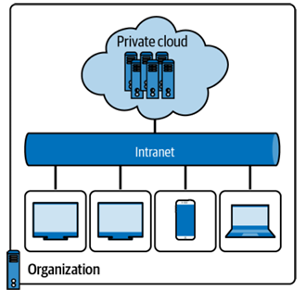
Private Cloud
Solely operated by one organization.
Enhanced privacy and security.
On or off-premises.

Slide 19
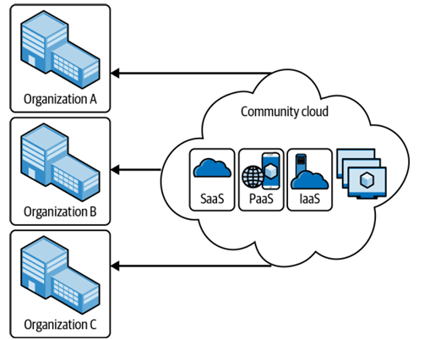
Community Cloud
Shared infrastructure for multiple organizations with similar needs.
Sectors: government, healthcare, education.
Maintains compliance with regulations.

Slide 20
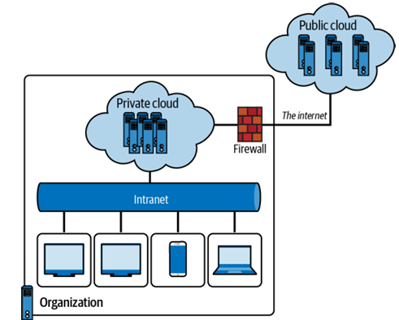
Hybrid Cloud
Combines private, public, and sometimes community clouds.
Unified, flexible, and cost-efficient.
Cloud bursting for increased workloads.

Slide 21
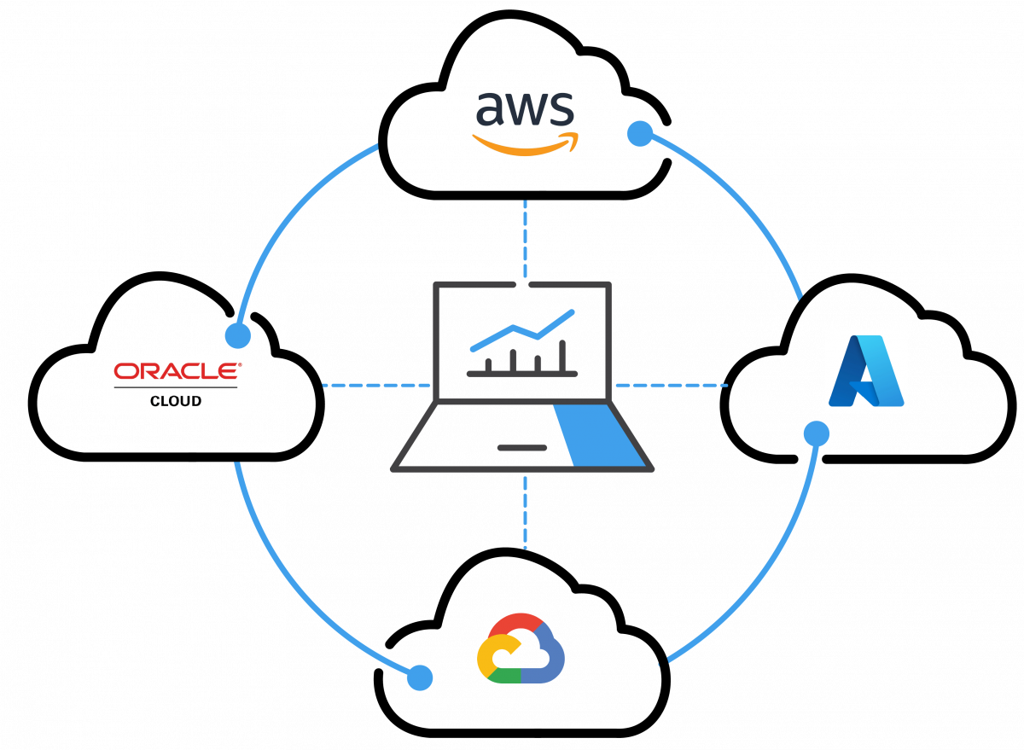
Multi-Cloud
Use of multiple public cloud providers (AWS, Azure, GCP).
Reduces downtime risk, optimizes costs, improves security.
Enhanced flexibility and performance.

Slide 22
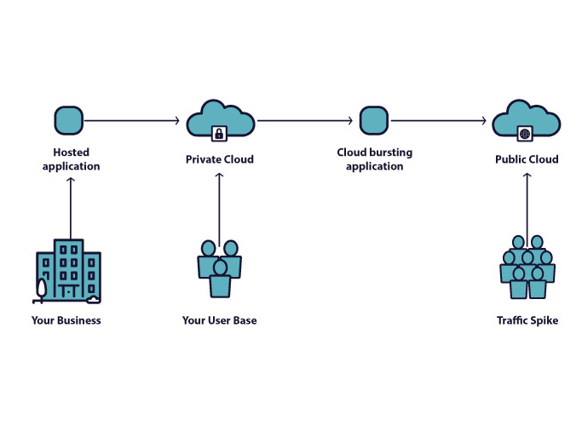
CLOUD BURSTING
Cloud bursting is common in hybrid cloud scenarios.
It is an application deployment in which an application runs in an on-premises data center or private cloud.
Then it can burst into a public cloud if the workload or computing capacity demands increase, thus granting access to more computing resources when needed.
Benefits of cloud bursting are its agility and ability to adjust to rapidly changing workloads. It also provides a cost-effective way to scale up and down. One practical example is the flexibility to handle compute workload issues by rerouting the traffic from a private cloud and expanding or “bursting” it to the public cloud.
Concerns of Security

Slide 23
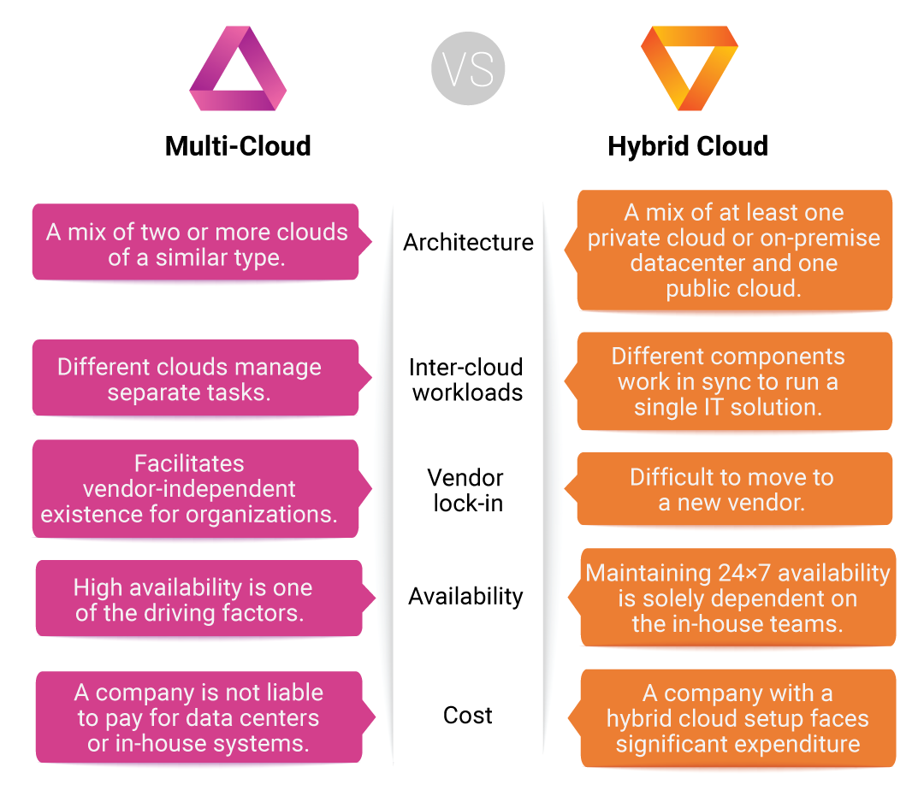
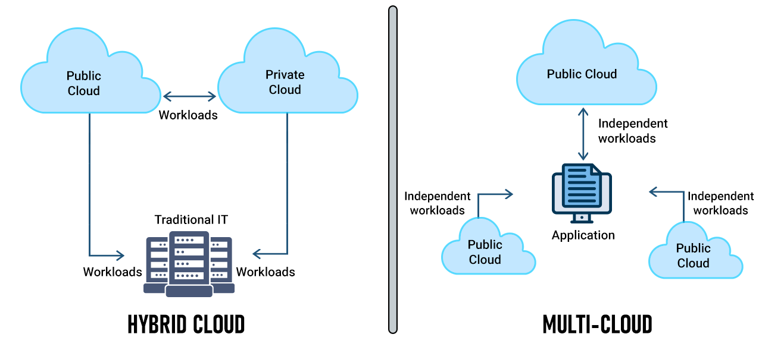
Hybrid VS MULTI CLOUD

Slide 24
Key Cloud Providers
1. Microsoft Azure: Wide range of services like AI, machine learning, and serverless computing.
2. AWS: Offers VPC, EC2, and S3 services.
3. Google Cloud Platform: Strong in AI, machine learning, and data services.
4. Oracle Cloud: SaaS and DaaS services.
5. Alibaba Cloud: Major player in China.

Slide 25
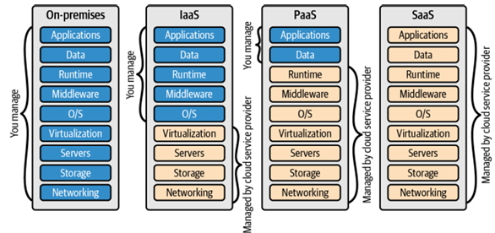
Cloud Computing Service Models

Slide 26
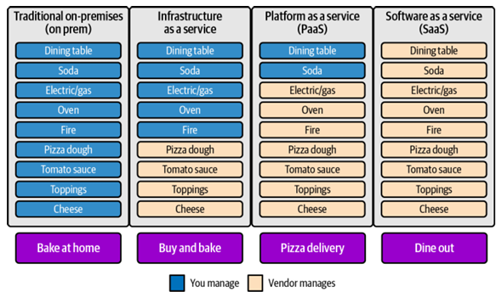
Cloud Computing Service Models

Slide 27
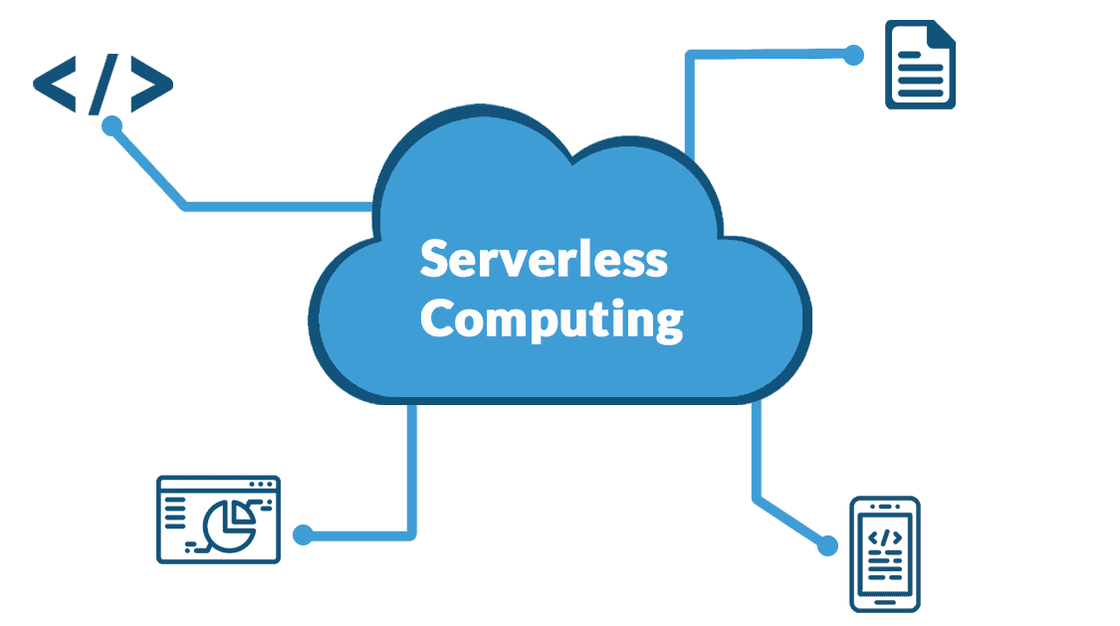
SERVERLESS COMPUTING
Definition: Cloud providers handle infrastructure and scaling, allowing developers to focus on code.
Infrastructure Management: Serverless abstracts server management, making resources available without manual setup.
Key Benefits:
Simplified development process.
Pay-per-use consumption model.
Event-driven architecture (triggers functions via HTTP requests, message queues, etc.).
Automatic scaling and reliability.
Azure Functions Example: Azure provides various serverless solutions like Azure Functions, Event Grid, and Logic Apps.
FaaS (Function as a Service): Developers write code that runs in stateless, managed compute instances.
BaaS (Backend as a Service): Abstracts backend infrastructure, focusing more on backend logic and services.

Slide 28
SERVERLESS COMPUTING : Benefits of Serverless, FaaS, and BaaS
Speed of Delivery: Focus on development, not infrastructure management.
Automatic Scaling: Scales as per demand.
Consumption-Based Pricing: Pay only for executed code.
Developer Focus: Focus on solving problems and delivering solutions.

Slide 29
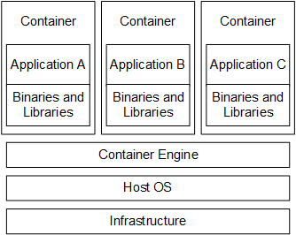
SERVERLESS COMPUTING : Containers as a Service (CaaS)
Definition: Containers provide a lightweight, fast runtime environment.
Key Features:
Cross-platform compatibility.
Lightweight and portable.
No need for application dependency installation.
High scalability and availability.
Faster startup times compared to virtual machines.
Docker Example: Docker is a popular container technology.

Slide 30
SERVERLESS COMPUTING : Data as a Service (DaaS)
Definition: Provides data management strategies as a cloud service, allowing organizations to manage large data sets effectively.
Key Benefits:
Enables a data-driven culture.
Facilitates business growth and innovation.
Offers scalability, flexibility, and reliability.
Monetizes data by organizing it for business needs.
Helps reduce costs by managing data workloads effectively.
Challenges:
Complexity in handling old or unstructured data.
Requires a top-down organizational strategy to implement a data-driven culture.
High demand for data privacy and security management, especially with compliance regulations.

Slide 31
Shared Responsibility in Cloud Computing
Strategic Evaluation: Organizations must carefully plan and strategize their cloud services.
Understanding Roles: The shared responsibility model helps define which tasks are managed by the cloud provider and which by the user.

Slide 32
Microsoft Azure's Cloud-Enabled Shared Responsibility Model
Division of Responsibilities: Varies based on cloud service type (SaaS, PaaS, IaaS, on-premises).
Service Selection: Helps organizations choose appropriate services and deployment models.
Security Clarity: Provides clarity on which security components are managed by Azure versus the organization.

Slide 33
Security Advantages of the Shared Responsibility Model
On-Premises Security Gaps: Traditional environments often lack sufficient resources to address security vulnerabilities.
Cloud-Based Security: The shared responsibility model enhances security by delineating tasks between provider and user.
Security Framework: Guides organizations in how to architect, design, and manage their data securely in the cloud.

Slide 34
Responsibilities of Cloud Providers and Users
Provider’s Role: Cloud provider (e.g., Azure) is responsible for:
protecting the cloud infrastructure
ensure data center security, availability, integrity, and compliance.
User’s Role: The user is responsible for:
securing their data
implementing access controls
managing identities
ensuring data protection (in transit and at rest).

Slide 35
Collaboration for Cloud Security
Shared Responsibility for Security: Both the cloud provider and the user have different roles in securing the cloud environment.
Compliance with Regulations: Both parties must work together to ensure the cloud environment is compliant with local regulations.

Slide 36
CapEx and OpEx in Cloud Migration
Critical Decision Factor: Organizations must evaluate the financial impact of CapEx vs. OpEx when migrating to the cloud.
Cost Efficiency: Comparing both expenditure models is essential for deciding cloud computing solutions.

Slide 37
Capital Expenditures (CapEx)
Definition: CapEx involves upfront capital costs for acquiring physical assets.
Types of Assets: Includes IT infrastructure, networking equipment, data centers, human resources, etc.
Fixed Nature: CapEx is not flexible and cannot be adjusted based on resource usage.
Example: One-time cost of purchasing a server, which doesn’t scale with usage.

Slide 38
Operational Expenditures (OpEx)
Definition: OpEx refers to ongoing, recurring expenses for maintaining business operations.
Variable Nature: OpEx can be adjusted based on usage, making it more flexible.
Examples: Cloud services, software licenses, salaries, and maintenance.
Efficiency: Allows businesses to pay as they go, optimizing resource allocation and reducing unnecessary spending.

Slide 39
Shift from CapEx to OpEx with Cloud Adoption
On-Premises Challenges: Traditional infrastructure requires significant CapEx for physical servers and data centers.
Cloud Advantage: Cloud services offer OpEx-based solutions, allowing businesses to eliminate traditional infrastructure and benefit from cost-saving and scalability.

Slide 40
BENEFITS: Cloud Computing for Business Value and Customers
Resource Efficiency: Cloud computing helps businesses save time, resources, and money by improving collaboration and productivity across teams.
Innovation Acceleration: It facilitates quicker modernization of applications, enhancing speed, user experience, and reliability.
Enhanced User Experience: Businesses can deliver faster, more reliable applications, creating better customer experiences.

Slide 41
BENEFITS: Cloud Computing for IT Companies
Data Access Management and Portability: Employees can access data from anywhere, ensuring efficient work processes even outside the office.
Cost Management and Efficiency: Using cloud services eliminates the cost and effort of maintaining physical servers, offering predictable monthly expenses.
Backup and Disaster Recovery Solutions: Cloud storage provides reliable backups, minimizing the risk of catastrophic data loss due to unforeseen events.
High-Level Cloud Security and Data Privacy: With the shared responsibility model, cloud providers like Microsoft Azure prioritize security and data privacy through identity management, physical data center security, and dedicated security teams.

Slide 42

BENEFITS: Digitalization and Modernization
Sector-Wide Modernization: Sectors like healthcare, government, and education benefit from the modernization enabled by cloud technologies, improving services and efficiency.
Remote and Flexible Education: The cloud supports digital literacy and remote education through online collaborative learning environments, allowing global access to education.

